Slide 1

The Service And Quality Level of Qatar Airways
By Sharon Effiong
Notes:
Hello Everyone, Today I will be presenting about my project: The Service and Quality level of Qatar airways but focusing more so on gathering insight in areas that may require improvement.

Slide 2
Table of Contents
Introduction/Purpose
Literature Review
Research Questions & Methodology
Findings
Recommendations
Future Research
Notes:
A brief overview of this presentation, it will start with an introduction, dive into the literature review, highlight the research question and methodology of the project, Express findings and insights, give Recommendations to the Airline and Finally address areas for future research.

Slide 3
01
Introduction
Introducing Presentation and Higlighting its Purpose

Slide 4
About Qatar Airways
Serving over 170 Destination
Main Hub located in Doha, Qatar
Multiple Award-Winning Airline
IATA Environmental Assesment Programme
Privillege Club
Partnerships with Various Teams Globally
Notes:
Qatar Airways serves over 170 destinations across five continents. Headquartered in Doha, Qatar, and operating from Hamad International Airport, the airline is widely recognized as a “multiple award-winning airline”and has won the world’s best airline for eight consecutive years. Qatar has strong commitments to environmental sustainability. Qatar has a loyalty program called Privillege club and also engages in strategic partnerships such as with F1 and FIFA.

Slide 5
Purpose
Examine Quality and Services Provided by Airline
Leverage Customer Feedback
Provide Qatar Airways with Valuable Insight for Improvement
Notes:
The purpose of this project is to examine the quality and services provided by Qatar Airways, with a focus on understanding passenger perceptions and identifying key areas for improvement. This study analyzes customer feedback to highlight areas where the airline can enhance its offerings. The goal is to provide Qatar Airways with valuable information to maintain and improve its reputation in a competitive industry.

Slide 6
02
Literature Review
Tying Back Scholarly Articles to Overall Topic.

Slide 7
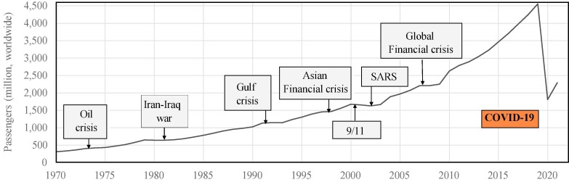
Covid-19 Pandemic and air Transportation: Summary of Recent Research, Policy Considerations and future research directions by xiaogian sun, sebastian wandelt, & Anming zhang
Disruptions Caused by Pandemic on Aviation Industry.
Passenger Number Declined by 60.2% for Domestic flights and 75.6% for International in 2020
Jobs related to aviation declined by 43%
Figure 1 shows how Pandemic Impacted Passenger Travel compared to other Global Events
Figure 1: The Unique Impact of COVID-19 on aviation in context of earlier crises in terms of the number of transported passengers worldwide (data source: IATA)
Notes:
In this Academic Article the authors reveal that passenger numbers dropped by 60.2% in 2020 for domestic and 75.6% for international. Jobs directly related to aviation declined by 43%. The figure shows how passenger numbers have historically fluctuated during significant global events and emphasizes the impact of the pandemic on the industry.

Slide 8
Taking stock of the pandemic’s iimpact on global aviation By: MCKinsey & Company
Extensive Financial Losses were incurred by the aviation industry, with airlines suffering the most
In 2020:
Airlines Loss: $167.9 Billion
Airport Loss: $31.6 Billion
Simultaneously:
Cargo Aircraft and Freight Forwarding Grew In Demand
Notes:
This aritcle talks about the extensive financial losses incurred across all sectors of the aviation industry. airlines reported $167.9 billion in losses and $31.6 billion for airports. At the same time demand increased for cargo aircraft and freight forwarding services during the pandemic. Due to financial hardships, Airline adaptations and changes could have contributed to customer perceptions of declining service standards.

Slide 9
The Pandemic Caused a Decrease of 2.7 Billion Passengers Worldwide in 2020
Economic Impacts of covid-19 on civil aviation by The Intetrnational Civil aviation organization (ICAO)
This Decrease Caused a 50% Reduction in Seat Availability
Low Availability Mixed With High Demand Resulted in Highly Inflated Ticket Prices
Inevitably Caused A Strain on Airline Operations
Notes:
A report by ICAO mentions the worldwide decrease of 2.7 billion passengers in 2020, alongside a 50% reduction in seat availability on flights. If flights were available, seat availability could not meet the demand, leading to inflated ticket prices. Many did not travel, further adding to the challenges faced by airlines. This caused a reduction in the workforce which often leads to a decline in service quality as customer expectations exceed what the limited workforce can deliver.

Slide 10
03
Research Questions
Summary of Conceptual Framework, Techniques Used, Cleaning Process, and Visualizations used

Slide 11
Breakdown
Research Questions | What are key words regarding qatar airways Before covid-19 and how have they differed? | What are frequent phrases used for qatar airways? | How do customers feel about qatar airways? | What are some words most similar to “Experience” based on reddit comments?
Technique | Keyword Frequency and Subgroup Comparison | Ngram Language Models (Bigrams) | Sentiment Analysis and Custom Lexicon | Word Embeddings
Data Wrangling | Pre-Process Data Create DTM Term Frequency Analysis Visualize | Convert to Tibble Tokenize Count and Clean Bigrams Unite Filtered Bigrams Visualize | Create Custom Lexicon Convert Lexicon to Tidy DF Inner_Join Data With Lexicon Visualize | Convert Data to UTF-8 Build Vocabulary and Co-Occurrence Matrix Create GloVe Model Explore Word Embeddings Identify Similar Words
Data Visualization | Bar Plot and Word Cloud | Bar Plot | Bar Plot | Plot
Notes:
Read of Slide: The entire dataset went through an initial cleaning process of removing irrelevant elements such as URL, Emails, Numbers and more. This was done using Regex Patterns. The data was then converted to lowercase and white spaces and empty rows were removed. The data was then tokenized
The first Research Question is:

Slide 12
About The Data Set
Information Extracted from Reddit and Kaggle
Kaggle Data Set: 2359 observations from 2013 - 2024
Reddit: Over 1400 Members and Was Started in 2018.
Done in Rstudio Using R
Packages Used: ReditExtractor, rtoot, word2vec, text2vec, keras, stringi, stringr, ggthemes, tm, tidytext, tidyr, dplyr, ggplot2, scales, readr, tidyverese, tokenizers, & magrittr
Notes:
Read from Slide

Slide 13
04
Findings
Breakdown of Analysis Findings For Each Technique Used
Notes:
Now I will discuss about Insights from the Analysis Process

Slide 14
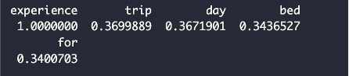
Word Vector of All words similar to “experience’
● “Trip”: Shared The Strongest Association with Experience
● “Day”: Also Appeared. Possibly related to comments regarding delays, travel schedules, or timelines in general.
● “Bed”: Could represent the experience in business class with the lie-flat beds.
Notes:
The term “trip” shares the strongest association with “experience.” While this word appears relevant in the context of travel, it does not offer specific insights into the nature of the experience, whether it’s positive or negative.
The word “day” could possibly relate to comments related to timelines, delays, or travel schedules. While it shares a relationship to “experience”, it again does not directly reflect the emotional or service-related aspects of customer feedback.
The word “bed” possibly points to feedback related to Qatar Airways' flatbeds in business or first class. This could be an indirect indication of positive feedback regarding comfort or luxury offerings; however, its relevance remains ambiguous without additional context.

Slide 15
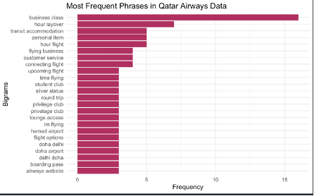
Frequent Phrases
● “Business Class”: Most Frequent Phrase. Expresses a Large interest From Passengers. Beneficial for Further Analysis to Interpret if Good or Bad Comments
● “Hour Layover” and “Transit Accomodation”: Reflect Passenger Experience With Layovers and Connecting Flights. May Be Regarding Frustration
● “Privilege Club” ,”Student Club”, and ‘Silver Status”: All Relate to the Airline’s Loyalty Program. Frequency of Overall Topic May Suggest an Issue With the Loyalty Program
● “Airline Website” : May Hint At Potential Challenges With the Website by Multiple Customers.
Notes:
The phrase “business class” emerged as the most frequently mentioned. This suggests that Qatar Airways’ business class service is a focal point for passengers, whether due to its luxury appeal or because of potential concerns or comparisons with competitors. Analyzing to Identify positive or Negative experience is Benficial for Qatar Airways to improve its image.
Phrases such as “hour layover” and “transit accommodation” likely reflect passenger experiences related to connecting flights and layover durations. These terms may suggest areas where customers commonly frustrated. So, Investigating the context surrounding these phrases could help the airline optimize layover experiences and improve customer satisfaction.
Phrases like “privilege club”, “student club”, and “silver status” indicate significant engagement with Qatar Airways’ loyalty programs. While this highlights customer interest in these programs, the frequency of mentions across multiple conversations could suggest issues regarding the programs’ benefits or eligibility requirements. This presents an opportunity for Qatar Airways to enhance communication and ensure clarity in its loyalty offerings.
The phrase “airways website” also appeared frequently, hinting at potential challenges customers may have faced when interacting with the airline’s digital platform. This warrants further investigation to identify specific improvements to enhance the user experience.

Slide 16
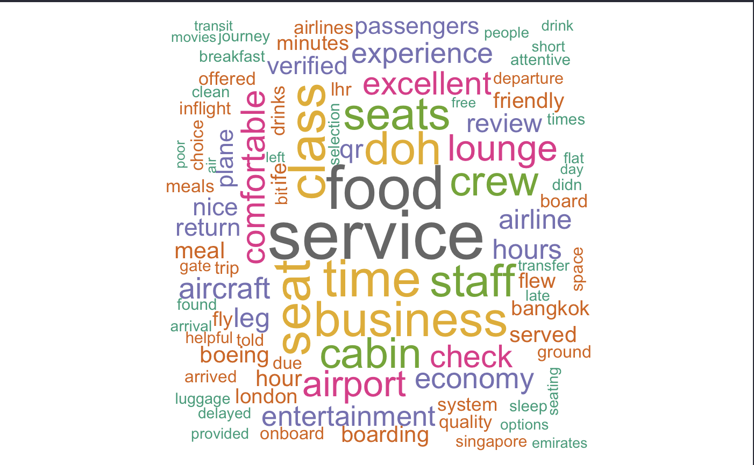
Frequent Words
● Service, Food, Crew, Time, Seat, and Lounge Dominated in the Word Cloud
● Business and Seat appearing indicated conversations on Seating and its Benefits
● Overall, reveal Airline Was Evaluated on Ability to Deliver Luxury, Comfort, and High-Quality Service
Pre-Covid
Notes:
The word cloud highlights a strong focus on passenger experience, with terms such as “service”, “food”, ‘crew”, “time”, and “seat” dominating the visualization suggesting that before the pandemic, passengers prioritized the quality of onboard services and comfort.
Words like “business” and “class” indicate frequent conversations about seating arrangements and the benefits of business class
These patterns reveal that passenger focus for Qatar Airways was often on its ability to deliver luxury, comfort, and high-quality services.

Slide 17
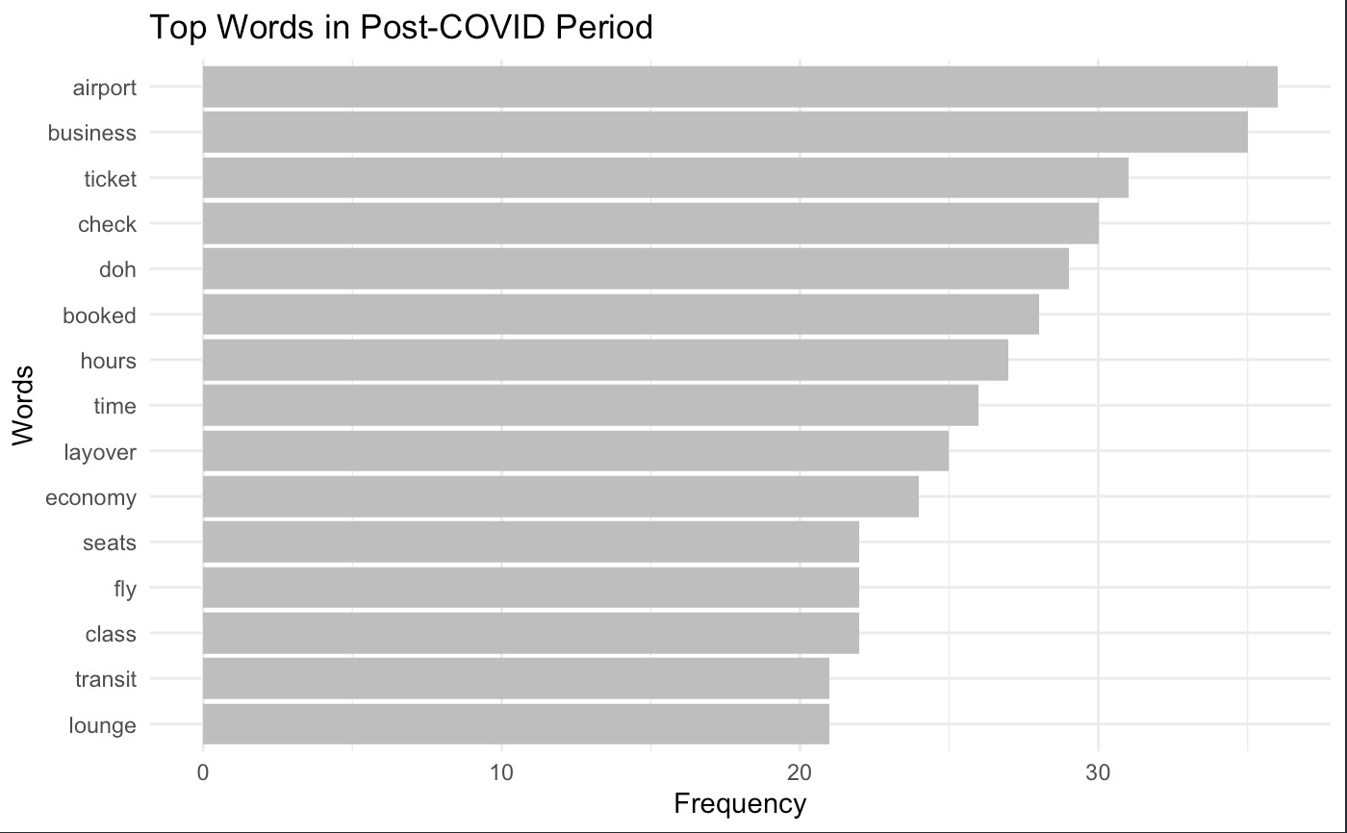
Frequent Words
● “Airport”: The Most Common Word Suggesting High Positive and Negative Experiences that May Provide More Insight Into Necessary Changes.
● “Business”: Possibly Referring to Business Class. Can either be Positive Responses From Those Flying Business or Negative Remarks
● “Ticket”: May be Related To Repeated Issues Regarding Booking, Pricing, or Modifications
● “Check”: Most Likely Relates to the Check-In Process at Airports. Possibly Multiple Complaints.
Post-Covid
Notes:
The word “airport” appears most frequently, suggesting that many comments revolve around passengers’ experiences at airports. This emphasizes the need for seamless airport operations and clear communication.
The frequent mention of “business” likely reflects Qatar Airways’ well-known business class as seen in other analysis. Analyzing the context surrounding this term could reveal whether customers are praising or expressing dissatisfaction with aspects of business-class.
The term “ticket” might refer to issues related to booking, pricing, or modifications.
“check,” most likely referring to the check-in processes, Given the heightened emphasis on health and safety post-pandemic, this term may also point to passenger concerns about new protocols introduced.

Slide 18
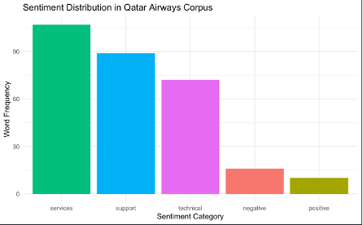
Sentiment Analysis With custom lexicon
● Services: High Word Frequency Suggests Quality Greatly Influences Customer Perceptions
● Support: Heavily Relates to Customer Service, Indicating High Importance of Shaping Customer Experiences
● Technical: Although Lower Than Top Two Categories, Still A Relatively High Word Count Frequency Within Category. Indicates Significant Points of Discussion Among Redittors.
● Negative and Postive: Both Low Overall. More Negative Sentiment within Comments.
Notes:
Words associated with the services category are the most frequent in the dataset. This high frequency suggests that service quality is a critical factor influencing customer perceptions.
The support category, which includes terms related to customer assistance also appear frequently. This reflects the importance of Qatar Airways’ customer service operations, especially when resolving issues.
While negative words occur more frequently than positive terms,” the lower overall frequency of these categories indicates that customers tend to focus on specific issues rather than expressing overarching sentiments.
This provides an excellent opportunity for Qatar Airways to address specific frustrations.

Slide 19
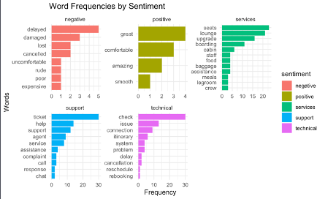
Sentiment Analysis With custom lexicon
● Negative: Delayed, Damaged, Lost, and Cancelled Are The Top Four. Emphasizes That Operational Disruptions and Customer Comfort Are Critical Pain Points
● Positive: Great, Comfortable, Amazing, and Smooth Are the Only Four Words. Highlight Positive Aspects: Seamless Experience, Comfortable Seating, and more
● Services: Seats, Lounge, Upgrade, and Boarding Are the Top Four. Shines light on Idea of Customers Evaluating Airline’s Service Delivery
Support: Ticket, Help, Support, and Agent Are At the Top of the List. Emphasizes Importance of Efficient Customer Support
Technical: Check, Issue, Connection, and Cancellation Appear On The List. Reflects High Operational Challenges and Logistic Issues
Notes:
Words such as “delayed”, “damaged”, “lost”, and, “cancelled” highlight common frustrations faced by passengers. These terms suggest that operational disruptions and customer comfort are critical pain points for Qatar Airways. Addressing these issues through enhanced communication and streamlined processes could significantly improve customer satisfaction.
Positive terms include “great”, “comfortable”, “amazing”, and “smooth.” These words highlight the aspects of the passenger journey that customers appreciate, such as seamless experiences, comfortable seating, and more. Qatar Airways can leverage this feedback to further enhance these strengths and differentiate itself from competitors.
Words such as “seats”, “lounge”, “upgrade”, “boarding”, and “crew” reflected frequent discussions about service quality. Ensuring a high focus of care in these areas is crucial for maintaining customer satisfaction.
Frequent words like “ticket”, “help”, “support”, and “agent” emphasize the importance of efficient customer support. Improving response times and streamlining support processes could address customer frustrations.
Words such as “check”, “issue”, “system”, “cancellation”, and “rebooking” reflect operational challenges and logistical issues faced by passengers. These terms highlight areas where operational inefficiencies or technical glitches may impact customer experiences.

Slide 20
05
Recommendations
Feedback to Qatar Airways Based on Findings
Notes:
Based On the Analysis Insights, Here Are recommendations for Qatar

Slide 21
Recommendations
Operational Improvements
Focus on Streamlining Processes at Airports
Invest in Systems to Improve Operations
In-Airport Improvements
Improve Lounge
Re-Design the Transit and Layover Experience
Service Quality
Continue Maintaining High Standards in Business Class
Improve Economy
Notes:
Operational improvements should focus on streamlining processes at airports, particularly in check-in, ticketing, and baggage handling, where frequent issues have been highlighted. Investing in an improved systems to minimize delays, cancellations, and rebooking frustrations is also essential.
Additionally, enhancing the transit and layover experience by improving lounge amenities, offering better accommodations, and ensuring top notch transfers occur at Hamad International Airport can significantly elevate customer satisfaction for transit passengers
Qatar Airways can strengthen its competitive edge by maintaining its high standards in business class while addressing economy class concerns such as seating comfort and in-flight entertainment.

Slide 22
Recommendations Continued
Customer Support Improvement
Provide Extensive Agent Training
Expand Assistance Capabilities
Ensure Timely Responses
Website Improvements
Upgrade Website Usability
Simplify Loyalty Program Process
Incorporate Real-Time Support
Notes:
By providing extensive agent training, expanding assistance capabilities, and ensuring timely responses, the airline can enhance its support services.
Furthermore, upgrading the usability of its website and app, simplifying loyalty program processes, and incorporating real-time support features can help resolve recurring customer frustrations and improve the overall digital experience
By addressing these concerns while leveraging its strengths in comfort and premium services, Qatar Airways can solidify its reputation as a leader in the aviation industry.

Slide 23
06
Future research
Breakdown of Analysis Findings For Each Technique Used

Slide 24
Future Research
Conduct More Thorough Sentiment Analysis Incorporating Other Categories
Map Customer Journey at Each Stage of Travel for Analysis
Notes:
Future studies could explore the specific emotions expressed, such as frustration, joy, or anger, to provide a deeper understanding of customer experiences. This can also be broken down further to understand business classes persective vs economy.
Another method could be to map the customer journey in greater detail to possibly offer more insights into specific points that most influence passenger satisfaction. This would be By analyzing feedback at each stage so pre-flight when booking or at check-in, in-airport at the lounge or when using transit services, in-flight by analyzing comfort levels or interest in amenities, and post-flight observing baggage claims feedback or general support feedback
Qatar Airways can pinpoint where improvements are most needed and could provide valuable information into improving customer expectations for Qatar Airways and allowing the airline to continue winning even more awards in the future.

Slide 25
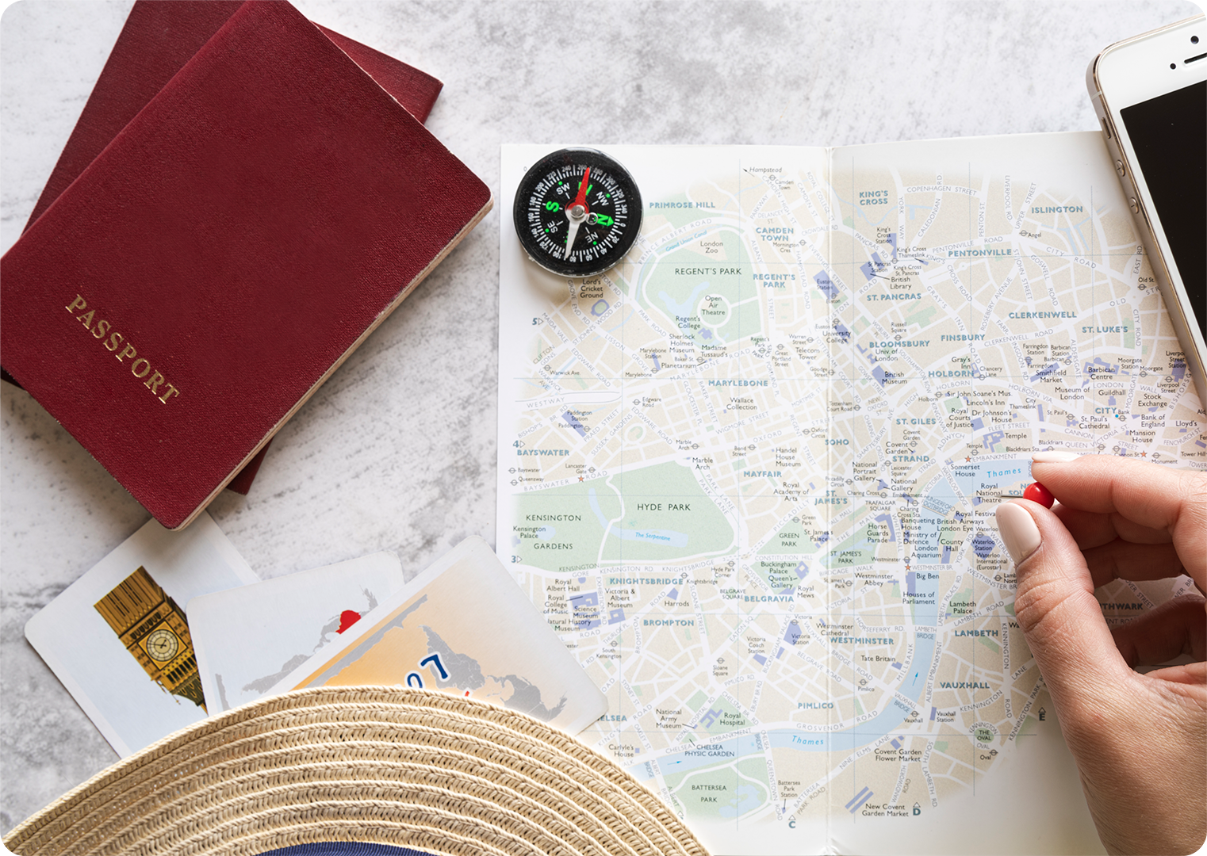

Thank you!

Slide 26
ALTERNATIVE RESOURCES

